Slide 1
Market Basket Analysis

Slide 2
The Team
Tom Kinyanjui
Lydia Mokaya
Duncan Kariuki
Elizabeth Ngandu
Kahiga Ndegwa

Slide 3
Keywords:
Support :- An indication of how frequently the items appear on Data
Confidence :- Likelihood that item B will be bought if A is bought
Lhs :- left hand side
Rhs :- Right hand side
Lift :- Ratio of the observed support if two rules are independent

Slide 4


Slide 5
Our clients (De Moules Supermarket Inc) is a chain of 81 supermarkets.Their outlets are found in New Hampshire, Massachusetts and Maine in United States.
Our goal is to do a market basket analysis on our client’s transactional data

Slide 6
Business Objective:
To identify the rules of association between products bought
To predict the items a customer will pick after the first item.

Slide 7


Slide 8
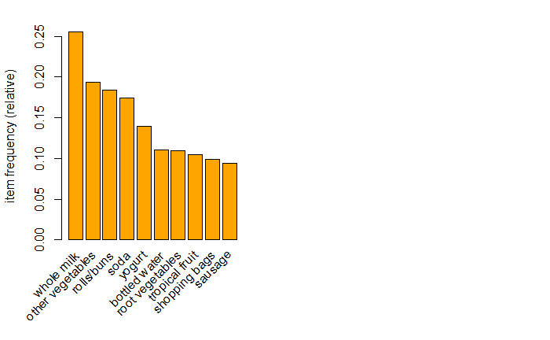

Slide 9
Most frequently bought items include:
* whole milk
* vegetables
* rolls/buns
* soda
* yoghurt

Slide 10
2513 out of 9835 transaction had milk as one of the items in the set
The largest item set bought by a customer include 32 items
2159 transaction that were made were of 1 item set

Slide 11
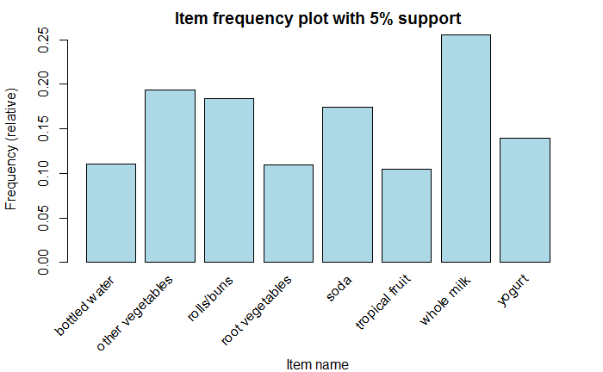

Slide 12
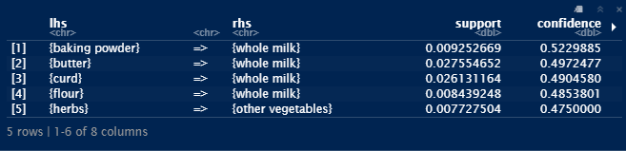
If I buy other products what is the probability that I will buy whole milk

Slide 13
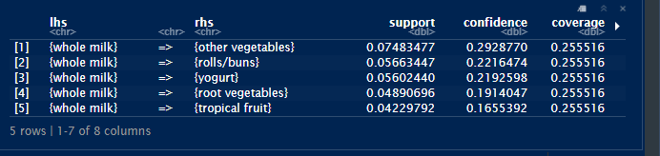
Buying whole milk before other products
Sorted by confidence

Slide 14
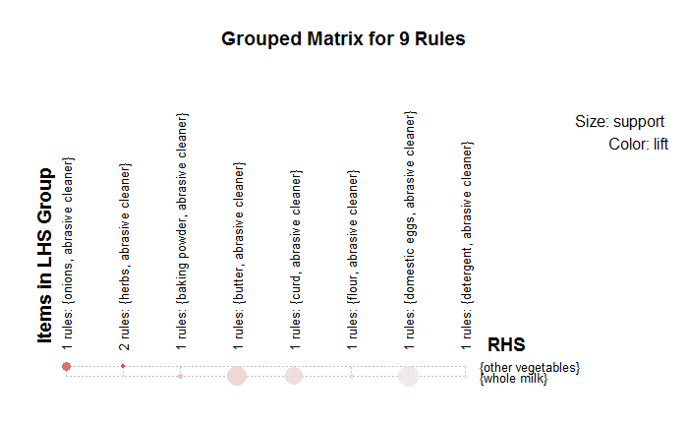

Slide 15
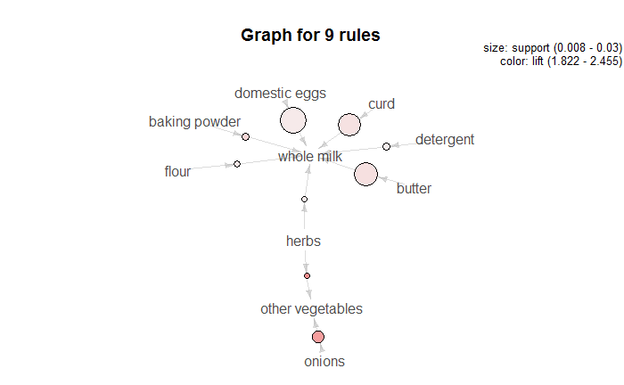

Slide 16


Slide 17
Conclusions & Recommendation
Herbs and other vegetables is the item set with the highest lift value hence the store should ensure that they are placed near each other to maximize on sale
Domestic eggs and whole milk are the most popular/ purchased combination set, hence the stores should ensure they always in stock to meet the demand.

Slide 18
Thanks!
Any questions?

